Slide 1




SEXUAL AND REPRODUCTIVE HEALTH (SRH) CARE THROUGH A GENDERED LENS
A PRESENTATION FOR HEALTHCARE PROVIDERS
By [Insert name]
[Insert Title and Partner Organization]

Slide 2

OUTLINE
INTRODUCTION
GENDER EQUALITY, GENDER EQUITY, AND ITS IMPACTS ON SEXUAL REPRODUCTIVE HEALTH AND RIGHTS (SRHR)
GENDERED LENS ASSESSMENT OF SEXUAL REPRODUCTIVE HEALTH AND RIGHTS (SRHR)
GENDER EQUALITY AND SEXUAL REPRODUCTIVE HEALTH AND RIGHTS (SRHR)
STEPS TOWARDS GENDER TRANSFORMATIVE CHANGE IN OUR WORK
CONCLUSION

Slide 3


LAND & AFRICAN ANCESTRY ACKNOWLEDGEMENT
We acknowledge that the land on which we gather in Treaty Six Territory is the traditional gathering place for many Indigenous people. We honor and respect the history, languages, ceremonies and culture of the First Nations, Métis and Inuit who call this territory home.
This is an acknowledgement of the people of the African Diaspora who have been uprooted, enslaved, and displaced in Canada and North America. The presence of African, Caribbean, and Black people in Canada cannot be unlinked from their colonial past which has, and continues to have negative impacts on ACB people in Canada.

Slide 4



PROJECT
OVERVIEW
CHABAC
The Canadian HIV/AIDS Black, African and Caribbean (CHABAC) Network was founded in 2010 to mobilize a national strategic response to HIV in African, Caribbean, and Black (ACB) communities and is currently hosted by HIV Network of Edmonton Society, a charitable organization that is dedicated to making life better for people living with or affected by HIV and AIDS.
GOAL
Increase the capacity of SRH programs and services across 4 Canadian provinces to serve ACB communities, particularly women, 2SLGBTQI+ people, newcomers, and Black youth through healthcare provider (HCP) and community capacity building.

Slide 5








PROCESS
Subject Matter Experts (SME)
Working group & Advisory group sessions
Awareness & training resources for Healthcare providers (HCPs) and ACB populations.
Lived or living experience

Slide 6







PROJECT PARTNERS
Canadian HIV/AIDS Black, African & Caribbean Network
Afro-Canadian Positive Network of BC
The Canadian Centre for Global Studies
HIV Edmonton
Black Coalition for AIDS
Prevention
Women’s Health in Women’s Hands CHC
The views expressed herein do not necessarily represent the views of Health Canada

Slide 7

OBJECTIVES
This training for healthcare providers aims to:
Create a shared understanding of Gender equality and Gender equity
Increase understanding of the links between Sexual & Reproductive Health and Gender equality
Consider practical strategies to achieving the desired gender transformative change.

Slide 8


WHAT IS GENDER EQUALITY?
Gender Equality can be viewed as a situation in which access to rights or opportunities is unaffected by one’s gender. This posits that people of all genders should have equal access, opportunities, resources, and protections.
Source: International Planned Parenthood Federation Guide, 2023; p.7

Slide 9

WHAT IS GENDER EQUITY?
Gender Equity is a process of fair and just treatment and distribution of resources to all genders, free from discrimination to level the playing field.
Gender equity is vital to the fair and just treatment of all genders, as inequities historically, culturally and socially exist due to oppressive ideologies and gender norms.
Source: International Planned Parenthood Federation Guide, 2023; p.7
Notes:
*Gender Equality (having the same resources regardless of gender) vs Gender Equity (some have inherent advantages based on their gender so may need additional resources to achieve health outcome)
Extra Resource: The Equity Race Video

Slide 10
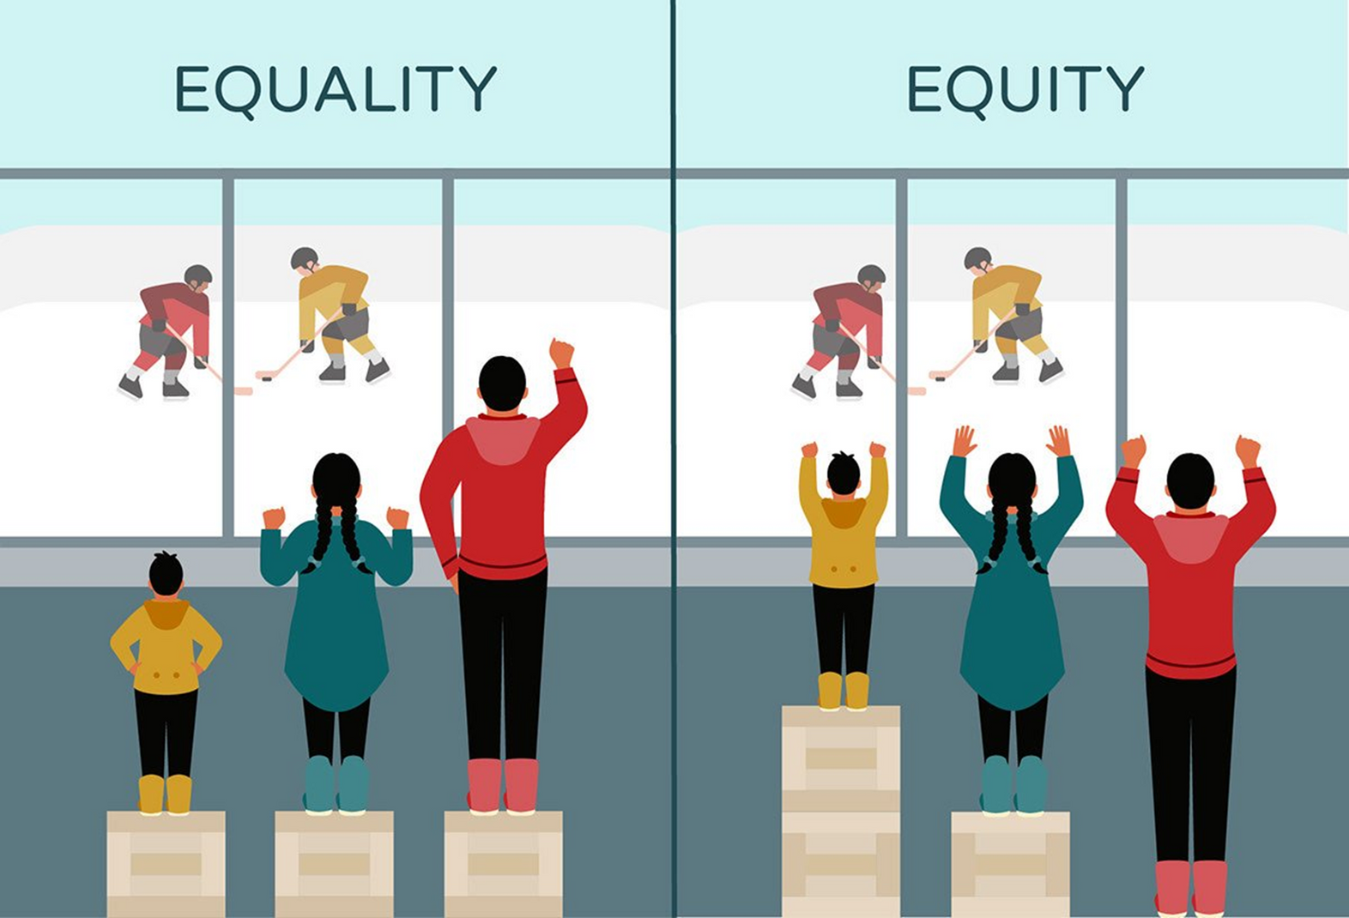
Source: Inuit Tapiriit Kanatami
Notes:
EQUALITY vs EQUITY:
When we’re focused on equality, we ensure that resources are divided equally regardless of individuals’ needs.
In this diagram, we see two ways of dividing resources. On the left side, we see that when we’re concerned about equality, everyone gets a step stool regardless of their needs. We are focused on the resources rather than the outcome – the outcome in this case is being able to watch the hockey game. The short person gets one step stool, which isn’t enough for them to reach the desired outcome. The tall person gets a stepstool even though they didn’t really need one. In this case, some of us are disadvantaged because our needs are greater than the system is set up to provide for.
On the right side, we see the resources distributed according to equity. Here, we’re concerned about everyone being able to reach the desired outcome, watching the hockey game. Everyone gets what they need to be able to see the hockey game, even though this means that everyone gets different resources. The short person gets two stools, the tall person gets none.
The desired outcome is that everyone experiences health in a way that aligns with their worldview. Everyone gets what they need to be as healthy as possible, and this need will be different for each person.

Slide 11

WHY IS THIS CONCEPT IMPORTANT TO SRH CARE?
•Gender inequalities/inequities produce/reproduce barriers to accessing SRH care.
•People with diverse sexual/gender identities are at an increased risk due to heterosexism, cissexism, homophobia, transphobia, etc.
•Unique barriers experienced due to harmful societal notions of masculinity and femininity (i.e. gender norms)
Notes:
- Expectations and informal rules on what it means to be a man, woman, trans, non-binary, etc. exist. These are shaped by culture and ideologies, and they influence behaviors.
- Gender norms influence how we think a person should act based on their gender/gender identity
- Harmful gender norms are the root cause of gender inequality, producing poor SRH outcomes

Slide 12


HUMAN RIGHTS APPROACH
“At the heart of a human rights-based approach (HRBA) is the recognition that inequality and marginalization deny people their human rights and keep them in poverty. An HRBA means that Canada’s international assistance contributes to the advancement of human rights.” (Canada, 2017)
Notes:
INFORMATION SOURCES
Definition of ACB-
BC Black History Awareness Society: https://bcblackhistory.ca/definitions/#:~:text=In%20Canada%2C%20Black%20Canadian%20is,the%20population%20group%20Visible%20Minority
Statistics-
https://www.statcan.gc.ca/en/dai/smr08/2023/smr08_270

Slide 13

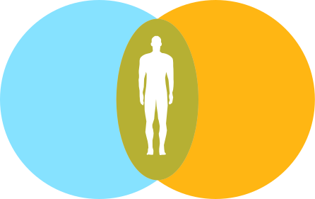

INTERSECTIONALITY
Coined by Kimberlé Crenshaw in 1989
Shows how our multiple identities intersect to create multiple forms of interlocking oppressions/privileges
Experiences of race, gender, sexual orientation, and other identity markers cannot be understood separate from each other
Notes:
- Intersectionality acknowledges that individuals experience the world through different lenses, and different identities affect the way people are viewed in society
- Gender equality can't be addressed in isolation, requires holistic approach that addresses intersecting structural elements and social identities, while responding to indivisibility of all human rights

Slide 14

GENDER TRANSFORMATIVE APPROACH
“A gender transformative approach actively strives to
examine, question, and change harmful gender norms and
imbalances of power in order to fulfill sexual and
reproductive health and rights, and realize gender equality. It
involves working holistically with people in all their diversity
using an inclusive person-centered and differentiated
approach as gender inequality affects different groups of
people in different ways.” (IPPF, p. 25, 2023)
Notes:
This approach:
- addresses multi-leveled power hierarchies in communities that create barriers in a person's ability to make decisions about their health,
- strives to shift gendered community perspectives and social relationships towards perspectives of equality that allow people of all genders to achieve their full potential
- should be implemented in all aspects of an intervention, policies, programming, design, implementation, and evaluation.
IPPF = International Planned Parenthood Federation

Slide 15
APPLICATION OF GENDER TRANSFORMATIVE APPROACH
AWARENESS OF GENDER ROLES & NORMS
QUESTIONING THE COSTS OF HARMFUL GENDER NORMS
EMPOWERMENT OF WOMEN, GIRLS & PEOPLE WITH DIVERSE GENDER IDENTITIES
ENGAGEMENT OF MEN & BOYS IN SRHR & GENDER EQUALITY
Notes:
Strategies in applying a gender transformation approach include:
1. Encouraging critical awareness of gender roles and norms
2. Questioning the costs of harmful, inequitable gender norms in
relation to SRHR and making explicit the advantages of changing them
3. Empowering women and girls and people with diverse sexual/gender identities
4. Engaging boys and men in SRHR and gender equality

Slide 16
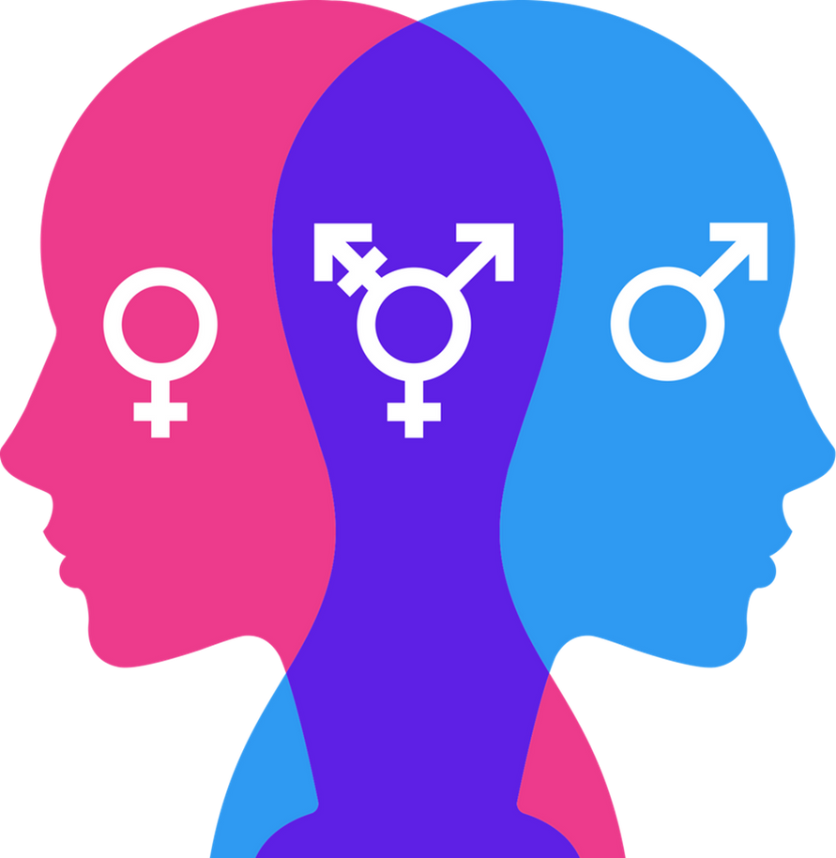
GENDER INTEGRATION CONTINUUM
Notes:
The Gender Integration Continuum supports the development/implementation of policies, programs by assessing how gender aware they are.

Slide 17
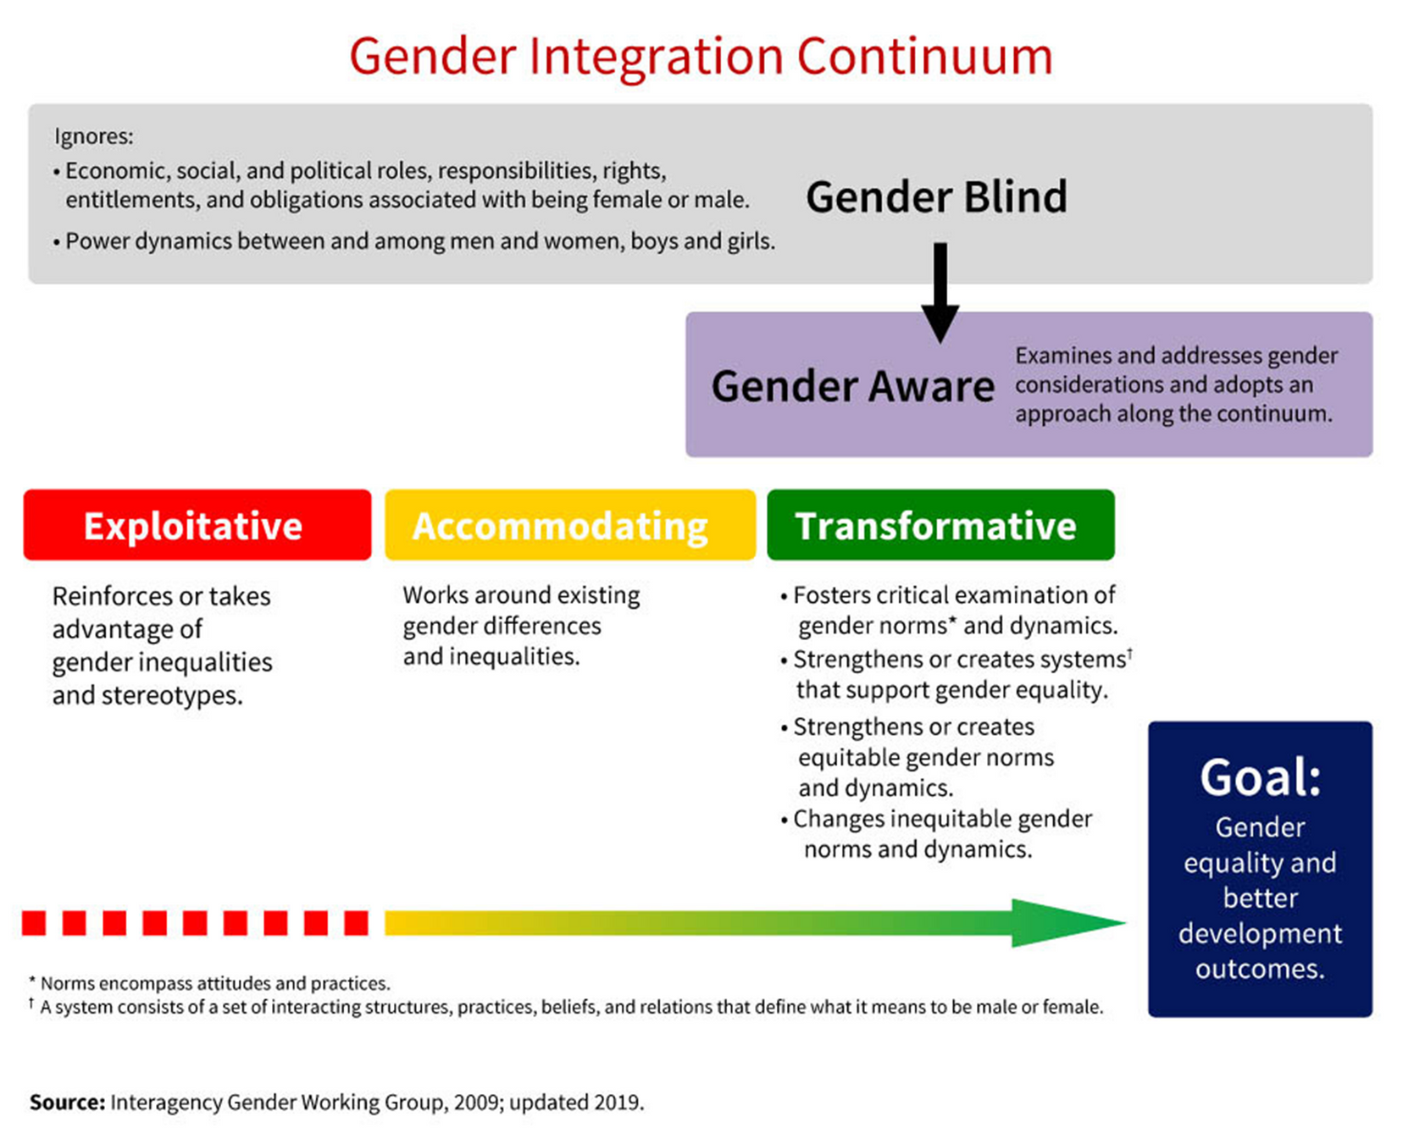

Slide 18



MAKING THE LINKS
SEXUAL & GENDER BASED VIOLENCE
HIV & OTHER STIs
COMPREHENSIVE SEXUALITY EDUCATION
ACCESS TO SRH SERVICES
Notes:
* Linking gender equality to SRHR supports an individual’s ability to make decisions about their sexual health that are free of coercion, discrimination, and violence. It is also a way of increasing awareness of one’s rights, which encourages them to exercise their rights. Let's explore the links between some SRH concepts & gender equality:
SGBV: caused by gender inequality. Unequal power dynamics, rigid gender norms, roles, and hierarchies, girls, women, and people who are sexually/gender diverse, who experience marginalization due to falling outside of societal norms
- preventing SGBV requires work from the ground up to challenge harmful gender norms and practices, as well as providing comprehensive SRH care for SGBV survivors (i.e. health care, legal support, emergency housing, etc.)
CSE: can greatly improve gender equality and SRH outcomes by focusing on gender, power, and rights
- it is more likely to show an increase in knowledge, and impact on attitudes, behavior change, and health outcomes
- a decrease in STI acquisition and unintended pregnancies
contributes to prevention/reduction of SGBV
Access to SRH Services: harmful gender norms and unequal power dynamics have a disproportionate impact on women and girls
- impacts decision making when it comes to consensual sexual experiences, contraceptive use/condom negotiation, access to SRH services
- people who are sexually/gender diverse, women girls frequently lack bodily autonomy, which also impacts their choices/decision making when it comes to their SRH
- lower social status, fewer opportunities, less decision making power affects their access to SRH services
actively working towards changing harmful norms and unequal power dynamics improves access to SRH services
HIV and other STIs: harmful gender norms disproportionately impact women, girls, and sexually/gender diverse people due to lack of bodily autonomy
- increases vulnerabilities when it comes to having consensual sex, discussing sexual history and testing, and negotiating condom use
- can be seen by disproportionate HIV diagnosis rates among women, particularly among Black and Indigenous women, as well as GBMSM, trans women
- also impacts treatment (men less likely to test for HIV, have greater challenges starting/adhering to treatment due to gender norms that impact men)
- increased stigma experienced by sexually/gender diverse people due to HIV epidemic, produces poorer health outcomes due to delayed treatment and care
- transforming harmful gender norms, unequal power dynamics can decrease vulnerability in HIV/STI acquisition, as well as increase timely access to care and treatment adherence.

Slide 19

DISCUSSION
What are some steps that we can take towards gender transformative change in our work with ACB communities?
Notes:
Pause to give participants room to answer before moving to the next two slides to discuss some steps

Slide 20
STEPS TO GENDER TRANSFORMATIVE CHANGE
BUILDING NATIONAL & REGIONAL PARTNERSHIPS
COLLECTION & ANNUAL PUBLICATION OF GENDER-BASED DATA
CAMPAIGN FOR SUFFICIENT RESOURCE ALLOCATION FOR GENDER PROGRAMMING
ASSESSMENT OF NATIONAL POLICIES & LAWS FOR HARMFUL GENDER NORMS & PRACTICES
SUPPORT OF GENDER EQUALITY BY NATIONAL FRAMEWORKS
Notes:
1. Ensure national frameworks specifically support gender equality by overcoming gender-based discrimination, combating harmful gender norms and practices
2. Assess national policies, laws, and statutes on gender equality, harmful gender norms, and discriminatory practices. Highlight those that need to be amended/improved, advocate for improvement, as well as how well they uphold gender equality laws
3. Campaign for sufficient resources to be allocated for gender programming including budget lines at national and local levels. A commitment to gender equality requires dedicated budget allocation to implement effective gender transformative approaches, and uphold relevant laws
4. Push for national health data to be disaggregated by age and sex, and supplemented by gender data, and to be published at least annually. This is crucial in identifying gender inequalities in health care and thereafter using an intersectional lens to address the unique needs of people who experience multiple forms of marginalization/ discrimination
5. Work with national and regional stakeholders – including with governments – to improve gender equality. This involves building partnerships with and/or creating national/regional networks.

Slide 21
STEPS TO GENDER TRANSFORMATIVE CHANGE
USE OF GENDER TRANSFORMATIVE LANGUAGE
INVOLVEMENT IN EXISTING ACCOUNTABILITY MECHANISMS
RESEARCH GENDER PAY GAP IN NATIONAL INSTITUTIONS
ENGAGEMENT OF PEOPLE WITH POWER & INFLUENCE FOR REFORMS
ADVOCACY FOR PROGRAMS THAT SUPPORT GENDER EQUALITY
Notes:
6. Advocate for implementation of programs that will support gender equality such as Comprehensive Sexuality Education (CSE) for young people, culturally relevant CSE etc.
7. Engage men/people who are in positions of power and influence - including community and religious leaders – to bring about legal and policy reforms that support gender equality
8. Research if there is a gender pay gap in national institutions
9. Get involved in national and regional accountability mechanisms to assess if proper accountability measures are actually being implemented
10. Ensure all communications materials use gender transformative language and images to dispel myths, misinformation, combat heteronormativity/CIS normativity

Slide 22


CONCLUSION
Gender inequality and gender inequity act as barriers to exercising one’s sexual reproductive health and rights (SRHR). Adopting a gender transformative approach to sexual and reproductive health care delivery is critical to achieving gender equality and better health outcomes within the ACB community.

Slide 23
REFERENCES
  Applying a gender lens to SRHR. IPPF. (2023, September 22). https://www.ippf.org/resource/applying-gender-lens-srhr
  Canada, G. A. (2017, May 26). Government of Canada. GAC. https://www.international.gc.ca/world-monde/issues_development-enjeux_developpement/priorities-priorites/human_rights-droits_personne.aspx?lang=eng
  Communication gender transformative approaches H capacity an HC3 ... (n.d.). https://www.healthcommcapacity.org/wp-content/uploads/2014/08/Gender-Transformative-Approaches-An-HC3-Research-Primer.pdf
  The Gender Integration Continuum . (n.d.). Retrieved from https://www.igwg.org/about-igwg/.

Slide 24

THANK YOU FOR YOUR TIME
Questions?

Slide 25






CONTACT INFORMATION
chabac srh project
chabac_srh
chabac.srh.project23@gmail.com
[Insert Name of Presenter]
[Job Title]
[Partner Organization]
[Organization Address]
[Your official email address]
[Organization Website and Social Media Handles]
Notes:
*Remember to edit lower portion of the slide to reflect Contact information of Presenter

