Slide 1




THE IMPACT OF CULTURAL HISTORY ON AFRICAN, CARIBBEAN & BLACK (ACB) HEALTH
A PRESENTATION FOR HEALTHCARE PROVIDERS
By [insert Name]
[Job Title, Partner Organization Name]
Notes:
Edit the name, title and partner organization name

Slide 2

OUTLINE
ACKNOWLEDGEMENTS
PROJECT OVERVIEW & PARTNERS
OBJECTIVES
INTRODUCTION
CULTURAL INFLUENCES ON SEXUAL & REPRODUCTIVE HEALTH (SRH)
HISTORY OF AFRICAN, CARIBBEAN AND BLACK (ACB) POPULATION
BUILDING TRUST & CULTURAL COMPETENCE
CONCLUSION

Slide 3


LAND & AFRICAN ANCESTRY ACKNOWLEDGEMENT
We acknowledge that the land on which we gather in Treaty Six Territory is the traditional gathering place for many Indigenous people. We honor and respect the history, languages, ceremonies and culture of the First Nations, Métis and Inuit who call this territory home.
This is an acknowledgement of the people of the African Diaspora who have been uprooted, enslaved, and displaced in Canada and North America. The presence of African, Caribbean, and Black people in Canada cannot be unlinked from their colonial past which has, and continues to have negative impacts on ACB people in Canada.
Notes:
Each region/hub should edit the land acknowledgement to suit the city where the presentation is being facilitated. Remember to keep it short and concise.

Slide 4



PROJECT
OVERVIEW
CHABAC
The Canadian HIV/AIDS Black, African and Caribbean (CHABAC) Network was founded in 2010 to mobilize a national strategic response to HIV in African, Caribbean, and Black (ACB) communities and is currently hosted by HIV Network of Edmonton Society, a charitable organization that is dedicated to making life better for people living with or affected by HIV and AIDS.
GOAL
Increase the capacity of SRH programs and services across 4 Canadian provinces to serve ACB communities, particularly women, 2SLGBTQI+ people, newcomers, and Black youth through healthcare provider (HCP) and community capacity building.

Slide 5








PROCESS
Subject Matter Experts (SME)
Working group & Advisory group sessions
Awareness & training resources for Healthcare providers (HCPs) and ACB populations.
Lived or living experience

Slide 6







PROJECT PARTNERS
Canadian HIV/AIDS Black, African & Caribbean Network
Afro-Canadian Positive Network of BC
The Canadian Centre for Global Studies
HIV Edmonton
Black Coalition for AIDS
Prevention
Women’s Health in Women’s Hands CHC
The views expressed herein do not necessarily represent the views of Health Canada

Slide 7

OBJECTIVES
Understand the cultural history of African, Caribbean and Black (ACB) communities
Recognize the impact of cultural differences as it relates to Sexual and Reproductive Health (SRH)
Obtain strategies to provide culturally competent care to ACB communities
Notes:
A focus on the cultural history of African, Caribbean, and Black populations in the context of sexual and reproductive health recognizes the significant influence of cultural factors on individuals' attitudes, behaviors, and access to healthcare services.

Slide 8

DEFINITION OF KEY TERMS
African, Caribbean & Black (ACB): People of African or Caribbean ancestry or who self-identify as Black visible minority who have resided in Canada for many generations or recently migrated. It includes Black Canadians with distinct ethnic, cultural and linguistic backgrounds and experiences (BC Black History Awareness Society, 2023).
Culture: The customary beliefs, social forms, and material traits of a racial, religious, or social group (Merriam Webster Dictionary, 2024).
Sexual and Reproductive Health (SRH): All-round wellbeing as regards sexuality, and involves the ability to have safe sexual experiences, make decisions regarding sex and reproduction freely and securely, as well as the protection and fulfillment of individual sexual and reproductive rights (World Health Organization, 2006 ; Public Health Agency of Canada, 2023).
Notes:
Merriam-Webster. (n.d.). Culture. In Merriam-Webster.com dictionary. Retrieved January 25, 2024, from https://www.merriam-webster.com/dictionary/culture

Slide 9

ACB DEMOGRAPHICS: 2021
REPORTED NUMBER OF ACB PEOPLE
1.5 MILLION
GROWTH OF ACB PEOPLE
(2016 - 2021)
349, 000
% OF CANADA‘S TOTAL POPULATION
4.3%
IN CANADA
% OF RACIALIZED POPULATION
16.1%
% OF CHILDREN 15 & UNDER IN ACB POPULATION
26.1%
% OF ACB CHILDREN IN OVERALL POPULATION
16.5%
Source: Statistics Canada, 2023
Notes:
https://www.statcan.gc.ca/en/dai/smr08/2023/smr08_270
Statistics Canada. 2023. (table). Census Profile. 2021 Census of Population. Statistics Canada Catalogue no. 98-316-X2021001. Ottawa. Released November 15, 2023.
https://www12.statcan.gc.ca/census-recensement/2021/dp-pd/prof/index.cfm?Lang=E (accessed January 25, 2024).

Slide 10
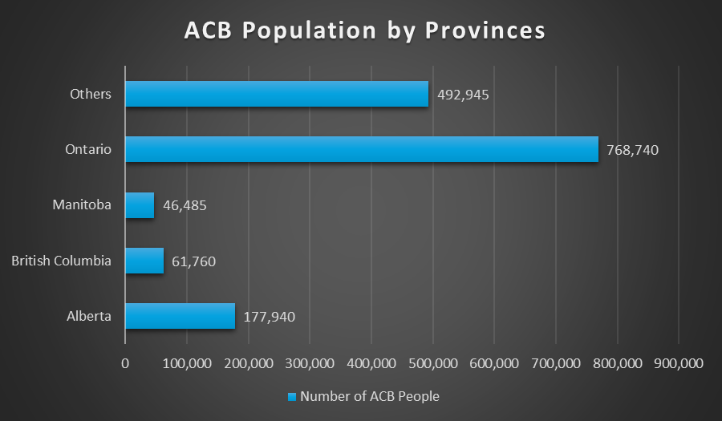
ACB DEMOGRAPHICS: 2021
Source: Statistics Canada, 2023
Notes:
ALBERTA:
177,940 ACB People = 4.2% of total Alberta population & 15.3% of visible minority in AB
BRITISH COLUMBIA:
61,760 ACB People = 1.2% of total BC population & 3.7% of visible minority in BC
MANITOBA:
46,485 ACB People = 3.5% of total Manitoba population & 16% of visible minority in MB
ONTARIO:
768,740 ACB People = 5.4 % of total Ontario population & 16% of visible minority in ON. 56% of all ACB people in Canada reside in Ontario.

Slide 11
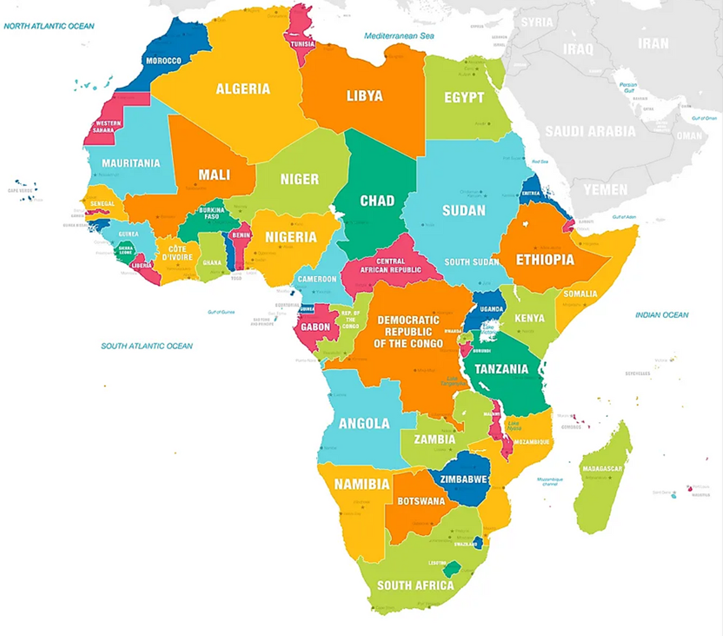
DIVERSITY OF AFRICAN PEOPLE
54 countries
5 regions: Northern, Western, Central, Southern and Eastern.
Distinct:
  Cultural practices
  Languages
  Cultural identities

Slide 12
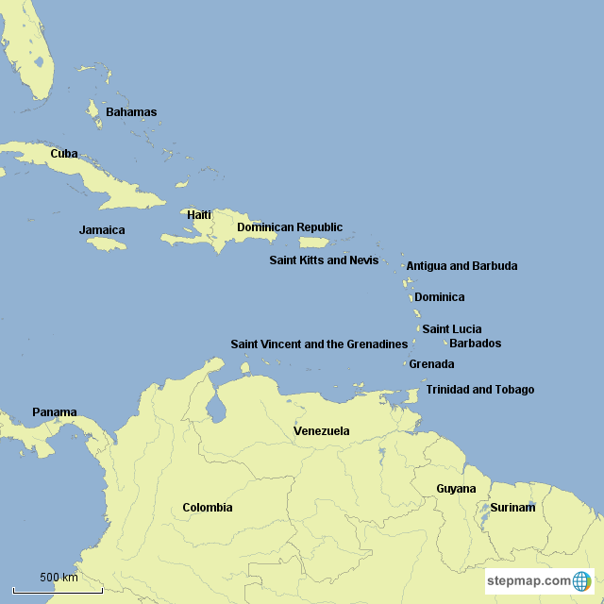
DIVERSITY OF CARIBBEAN PEOPLE
7000 Islands
32 Countries: 13 Sovereign states, 19 Non-sovereign states
Distinct cultural practices
British, Spanish, French, Dutch, African & Creole influences
Shaped by Indigenous cultures, European colonization, Trans- Atlantic Slave trade
Notes:
https://www.stepmap.com/map/caribbean-with-guyana-and-suriname-sPdUyxHSih-i

Slide 13



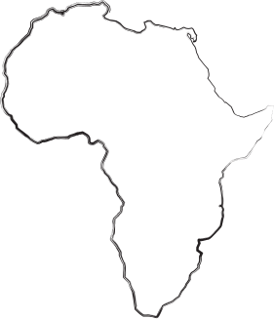


DIVERSITY OF BLACK PEOPLE
Includes people of African descent
Also in America, Europe, and other parts of the world
Featuring:
  Numerous additional languages
  Wide variety of religions
  Countless cultural practices

Slide 14
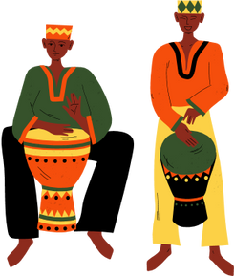
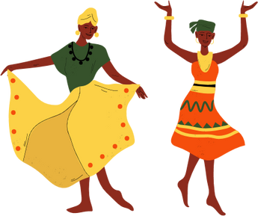
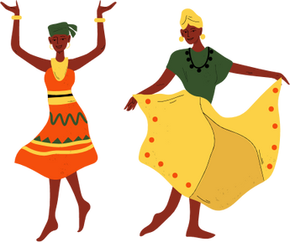
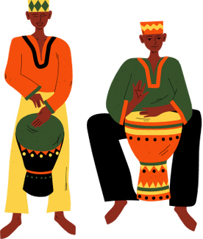
CULTURAL INFLUENCES ON SRH
CEREMONIAL PRACTICES
GENDER ROLES*
STIGMA & TABOO*
COLLECTIVISM & FAMILY VALUES
RELIGIOUS BELIEFS
CULTURAL MYTHS & FOLKLORE
Notes:
1. Collectivism & Family Values: SRH decisions are influenced by considerations for the family unit, community and other social groups that influence the beliefs/practices.
Example – in African communities decisions related to marriage, child birth and family planning often involve the input of the extended family member. The well being of the family unit is of more importance than the individual well-being or preference in SRH matters. [*May include examples from the Caribbean and Black communities as well to highlight cultural differences]
2. Ceremonial Practices: Some ACB communities have traditional ceremonies related to sexuality and reproduction. They signify transitions into adult hood, marriage or parent hood. i.e. coming-of-age ceremonies.
"coming-of-age" ceremonies in some African cultures, may include teachings on sexuality and reproductive responsibilities. These ceremonies play a role in transmitting cultural values and expectations related to family life.
3.Religious Beliefs: Religion plays significant roles in norms and practices related to how communities maintain norms and develop practices surrounding SRH.
Different ACB communities may adhere to carious religious beliefs which significantly impact perspectives on contraception, family planning and sexual ethics.
Caribbean communities which are influences by Christianity, may hold conservative views on premarital sex and contraception. Religious teachings can shape attitudes toward family planning, with some communities discouraging the use of certain contraceptive methods based on religious teachings.
Religion impacts sexual ethics as many ACB 2LGBTQ+ faced discrimination within their communities due to religious beliefs around their sexual/gender identity being viewed as ‘unnatural’. This can create barriers to SRH care through fear of further discrimination, and delays in accessing health services.
4. Gender Roles: Gender roles influence expectations regarding sexual behavior and reproductive responsibilities with implications for women's autonomy and men's involvement in reproductive health
Traditional gender roles in some African societies may dictate that men are primarily responsible for decisions related to family planning, while women are expected to prioritize childbearing. This can impact women's autonomy in making choices about their reproductive health. Gender roles have unique impacts on ACB people who are members of the 2SLGBTQ+ community. Many ACB 2SLGBTQ+ did not feel safe to come out within their families/communities due to rigid expectations of sexual relationships and gender expression/presentation (a by-product of the attempted erasure of African sexual/gender diversity pre-colonial context).
5. Cultural Myths & Folklore: Cultural myths and folklore may influence perceptions of fertility, contraception, and sexually transmitted infections. this impacts the attitudes surrounding sexual health practices and the spread of misinformation.
African communities, there may be myths or folklore about the effectiveness of traditional remedies for fertility issues. This impacts decision making around modern medical interventions for SRH challenges.
There is also a lack of resources provided to African/Caribbean communities when it comes to researching and studying the efficacy of traditional remedies. For example, cerasee tea is a common bush tea that is consumed in the Caribbean, which has been linked to having abortifacient/contraceptive properties (Kubala, 2021).
6. Stigma & Taboo: A reluctance to discuss SRH related topics exists in many ACB communities. Such topics are sometimes seen as Taboos.
We'll be talking more on Gender roles, Stigma and Taboo in the following slides.

Slide 15

STIGMA & TABOO
Stigma surrounding sexual health - discussion of sexual matters openly
Stigma regarding reproductive choices - Premarital sex, contraception and abortion
Stigma due to heterosexism, cissexism, homophobia, transphobia
HIV/AIDS Stigma
Mental Health Stigma - access to care, talking about it
Notes:
1. In some Caribbean communities, there may be reluctance to openly discuss sexual health matters due to cultural taboos. This silence can contribute to a lack of awareness about safe sexual practices and hinder efforts to prevent and address sexually transmitted infections.
2.Stigma around premarital sex in some African communities might discourage open discussions about contraception or family planning. Individuals may face judgment or social exclusion if their reproductive choices do not fall in the category of what is normally acceptable.
3. The stigma is increased when we look at the intersection of race, gender, and/or sexual orientation. Sexually/gender diverse ACB people face stigma around their sexual orientation and/or gender identity. Since sex as a whole is viewed as taboo, sexual practices and/or gender expression that falls outside ‘acceptable societal norms’ can further contribute to silence within the community.
4. HIV/AIDS stigma leads to discrimination, fear, and avoidance of testing or disclosure, hindering effective prevention and management.
5. Mental Health Stigma can discourage persons who may be suffering from issues related to sexual trauma, infertility or post-partum from accessing care.

Slide 16

GENDER ROLES & POWER DYNAMICS
Patriarchal systems exist across the world and ACB communities are not left out. More often than not in those systems, men take the leading roles in the family while women are expected to be subservient.
Decision-making Authority
Communication Patterns
Economic Empowerment
Cultural Expectations
Reproductive Coercion
Notes:
In many ACB countries, men are the primary decision makers and are the ones who make decisions about sexual and reproductive health. Historically, they also often assumed the roles of providers/protector, while women took on the nurturing roles. Sometimes, these cultural beliefs are upheld even after migration to new countries like Canada.
Let's look at the following examples of Power Dynamics:
1.In relationships where power dynamics are unequal, the partner with more authority may exert greater influence over decisions related to contraception, family planning, and sexual health practices. This can impact the other partner’s autonomy in making choices about their reproductive health.
2. Unequal power dynamics can contribute to communication challenges within relationships. If one partner feels disempowered or fearful of expressing their needs or concerns, there may be limited communication about sexual health matters, potentially leading to misunderstandings or unmet needs.
3.Economic disparities between partners can influence decision-making about family planning. If one partner has greater financial resources, they may have more control over decisions related to fertility, contraception, and access to healthcare.
4.Cultural expectations regarding masculinity and femininity can shape power dynamics. For example, traditional expectations of men as authoritative decision-makers may limit open discussions about sexual health and family planning within relationships.
5.Power imbalances can contribute to reproductive coercion, where one partner exerts control over the other's reproductive choices. This can manifest as pressuring a partner to have children against their will or preventing access to contraception.

Slide 17

ADDRESSING POWER DYNAMICS
ESTABLISH CLEAR ROLES & RESPONSIBILITIES
COMMUNITY EMPOWERMENT PROGRAMS
ENCOURAGE COUPLE’S COUNSELLING & EDUCATION
PROMOTE GENDER EQUALITY
Notes:
1.: Efforts to promote gender equity within relationships and society at large can contribute to more balanced power dynamics. This involves challenging traditional gender norms that may limit individuals' agency in decisions about sexual and reproductive health.
2.Providing resources for couples counseling and education can facilitate open communication and shared decision-making. These interventions can address power imbalances and empower individuals to make informed choices about their sexual and reproductive health.
3.Community-based programs that focus on empowering both men and women (all partners or all genders) can contribute to changing cultural norms. These programs may include education on healthy relationships, gender equality, and the importance of shared decision-making in matters of sexual and reproductive health.
4. Establishing clear roles and responsibilities give room for autonomy in SRH matters.

Slide 18

HISTORICAL TRAUMA & ITS INFLUENCES
Historical Trauma - cumulative emotional and psychological wounding across generations which presents as Intergenerational trauma.
  Mental Health
  Health Behaviors
  Resilience & Strength
Notes:
• Mental health - Contributes to higher rates of stress, anxiety, depression.
Ongoing struggle against racism and discrimination compound these challenges.
• Health behaviours
- Influence substance use, unhealthy eating patterns,
Reluctance to seeking medical care due to mistrust.
• Resilience and strength
- Stick together as a community (stronger together concept)
Draw on cultural practices
*In order to address the disparities in the Healthcare system, one must acknowledge and address the historical roots of these issues and it must be acknowledged at all levels. Culturally competent healthcare, community-led conversations and policy changes that address systemic inequalities are important for promoting the health and well-being of Black Communities.

Slide 19

HISTORICAL EVENTS THAT LED TO MISTRUST
  Exploitation & Abuse - The Tuskegee Syphilis Study (CDC, 2022)
  Medical Experimentation - testing of new drugs in the colonial era without informed consent (Washington, 2007)
  Discrimination & Segregation - Denied access to medical facilities and services (Dryden and Nnorom, 2021)
  Systemic Racism and Bias (Mahabir et al., 2021)
  Forced Sterilization - the implementation of the Eugenics Program in the early 20th century (Alonso, 2020)
Notes:
* Masked experiences of Black People in Canada (by the Underground Railroad & other events) make getting historical data on past events challenging. Here are some historical events that contributed to mistrust in Black communities:
Tuskegee Syphilis Study - U.S. Study where about 400 Black men were left deliberately untreated for Syphilis. No informed consent taken neither was there full disclosure to participants about nature of study.
Medical Experimentation - the exploitation of African slaves for medical experimentation during the colonial era, use of marginalized populations for testing new drugs without informed consent. Different accounts are contained in Harriet Washington's book on Medical Apartheid (2007).
Discrimination & Segregation - Black people have been denied access to medical facilities and services through out history.
Systemic Racism and Bias: See Canadian Study, Mahabir et al. (2021) highlighted black women's experiences of racism when accessing healthcare.
Forced Sterilization: The Eugenics Program was implemented & approved in both the USA and Canada in the early 20th century. Black women were forcefully sterilized and had their reproductive rights repeatedly violated.

Slide 20

BUILDING TRUST: PRACTICAL TIPS FOR HCPs
OPEN & TRANSPARENT COMMUNICATION
STAFF DIVERSITY & INCLUSIVITY
CULTURAL COMPETENCY TRAINING
COMMUNITY ENGAGEMENT
Notes:
By fostering an environment of respect, understanding, and inclusivity, healthcare providers can contribute to rebuilding trust with patients and communities.
1. Invest in cultural competency training to understand the diverse backgrounds and beliefs of patients. Acknowledge and respect cultural nuances, recognizing that trust is often built through understanding and appreciation of individual and community values
2. Practice open and transparent communication. Clearly explain diagnoses, treatment options, and potential outcomes. Address any concerns or questions patients may have, fostering a sense of partnership in the decision-making process.
3. Strive for diversity and inclusivity in healthcare staff. Having a diverse healthcare team fosters a sense of belonging and helps patients feel more comfortable and understood.
4. Engage with the community to build relationships outside of clinical settings. Participate in community events, listen to concerns, and involve community leaders to address healthcare disparities collaboratively.

Slide 21


BUILDING TRUST: PRACTICAL TIPS FOR HCPs
PATIENT EMPOWERMENT
PATIENT AUTONOMY & INVOLVEMENT
ACCESSIBLE & EQUITABLE CARE
Notes:
To provide culturally competent care, it is crucial for HCPs to build trust with their patients. Here are more practical tips:
1 Empower patients through education. Provide clear and accessible information about health conditions, treatment options, and preventive measures. Informed patients are more likely to feel confident in their healthcare decisions.
2. Respect patient autonomy and involve them in decision-making. Ensure that patients feel heard and that their preferences and values are considered when determining treatment plans.
3. Strive to provide accessible and equitable care. Addressing disparities in healthcare access and outcomes is crucial for rebuilding trust. Efforts to reduce healthcare inequalities demonstrate a commitment to fairness and justice.

Slide 22


BENEFITS OF RECOGNIZING CULTURAL DIFFERENCES
  Cultural Competence & Effective Communication
  Promotes Access to Care
  Promotes Trust and Relationship Building
  Cultural Sensitivity in Decision Making
  Prevents Stereotyping and Prejudice
  Promotes Inclusivity and Diversity -> Tailored & Inclusive Care
Notes:
Due to the various cultural backgrounds and practices, histories, languages, beliefs, religions and traditions; to say that ACB communities are monolithic does great disservice to the varieties in these communities.

Slide 23

DELIVERING CULTURALLY COMPETENT CARE
  Ensure language access for patients with limited English proficiency.
  Provide patient education materials in multiple languages and formats.
  Approach each patient with cultural humility
  Establish feedback mechanisms
Notes:
1. Ensure language access for patients with limited English proficiency. Provide professional interpreters or translated materials to facilitate effective communication.
2. Provide patient education materials in multiple languages and formats. Clear and culturally sensitive educational materials help patients understand their health conditions and treatment options.
3. Approach each patient with cultural humility, recognizing that cultural competence is an ongoing learning process. Be open to understanding diverse perspectives and continuously strive to expand your cultural knowledge.
4. Establish feedback mechanisms to encourage patients to share their experiences and concerns regarding cultural competence. Continuous feedback allows healthcare providers to improve and refine their practices.

Slide 24

GROUP DISCUSSION
What has your experience been like providing care to the ACB community?
Notes:
Presenter to set the ball rolling by giving examples of experiences. Examples could include the following:
- Experience has been the same with other population
- Experienced difficulty in providing care
- Gained more cultural understanding while providing care.

Slide 25

TRUE OR FALSE
African, Caribbean, and Black communities are homogenous, with similar cultural beliefs and practices.
FALSE

Slide 26

TRUE OR FALSE
Historical trauma can have a lasting impact on the health outcomes of individuals within African, Caribbean, and Black communities.
TRUE

Slide 27
TRUE OR FALSE
Building trust with patients from African, Caribbean, and Black backgrounds is not necessary for providing quality healthcare.
FALSE

Slide 28
IMPORTANCE OF CULTURAL COMPETENCE
  Improves patient outcomes
  Enhances communication
  Increases trust and patient satisfaction
  Reduces health disparities
  Enhances provider-patient relationship
Notes:
Why is Cultural Competence Important?
1. Understanding cultural nuances helps healthcare providers tailor treatment plans that align with patients' values and beliefs, ultimately leading to improved adherence and satisfaction.
2.facilitates effective communication between healthcare providers and patients from diverse backgrounds. This includes recognizing language preferences, non-verbal cues, and communication styles that may differ across cultures.
3.Cultural competence builds trust, creating a positive healthcare experience for patients.
4.It aims to provide equitable care, reducing disparities among different population groups.
5.contributes to the establishment of strong and trusting relationships between healthcare providers and patients and can prove beneficial in managing health concerns

Slide 29

CONCLUSION
Recognizing and respecting the rich diversity within ACB communities is not just a professional responsibility, but a cornerstone for delivering equitable and inclusive sexual and reproductive healthcare.
By embracing cultural competence, healthcare providers can contribute to dismantling barriers and fostering a healthcare environment that meets the unique needs and preferences of each individual within ACB communities.

Slide 30
REFERENCES
  Alonso, P. (2020) ‘Autonomy Revoked: The Forced Sterilization of Women of color in 20th Century America’. Retrieved from chrome-extension://efaidnbmnnnibpcajpcglclefindmkaj/https://twu.edu/media/documents/history-government/Autonomy-Revoked--The-Forced-Sterilization-of-Women-of-Color-in-20th-Century-America.pdf
  BC Black History Awareness Society: https://bcblackhistory.ca/definitions/#:~:text=In%20Canada%2C%20Black%20Canadian%20is,the%20population%20group%20Visible%20Minority
  Centers for Disease Control and Prevention (2022) 'The Untreated Syphilis Study at Tuskegee Timeline'. Available at https://www.cdc.gov/tuskegee/timeline.htm
  Cultural competence in healthcare. Retrieved from https://publichealth.tulane.edu/blog/cultural-competence-in-healthcare/#:~:text=Cross%2Dcultural%20awareness%20makes%20healthcare,Improved%20rapport. Accessed November 5, 2023
  Dryden, O. and Nnorom, O. (2021) 'Time to dismantle systemic anti-Black racism in medicine in Canada', CMAJ, 193 (2) E55-E57; DOI: 10.1503/cmaj.201579
  Harriet A. Washington (2007) 'Medical Apartheid: The Dark History of Medical Experimentation on Black Americans from Colonial times to the present'. https://books.google.ca/books?id=apGhwRt6A7QC&q=Medical+Apartheid:+The+Dark+History+of+Medical+Experimentation+on+Black+Americans+from+Colonial+Times+to+the+Present&redir_esc=y#v=snippet&q=Medical%20Apartheid%3A%20The%20Dark%20History%20of%20Medical%20Experimentation%20on%20Black%20Americans%20from%20Colonial%20Times%20to%20the%20Present&f=false
  Information about Caribbean Islands - https://worldpopulationreview.com/country-rankings/caribbean-countries
Notes:
Alondra Nelson. Unequal Treatment: How African Americans have often been the unwitting victims of medical experiments The Washington Post, January 7, 2007. https://www.washingtonpost.com/wp-dyn/content/article/2007/01/05/AR2007010500180.html

Slide 31
REFERENCES
  Mahabir, D.F., O’Campo, P., Lofters, A., Shankardass, K., Salmon, C. and Muntaner, C. (2021) 'Experiences of everyday racism in Toronto’s health care system: a concept mapping study', Int J Equity Health, 20(1):74. doi: 10.1186/s12939-021-01410-9.
  Map of Africa - https://www.worldatlas.com/articles/how-many-countries-are-in-africa.html
  Map of the Caribbean - https://www.stepmap.com/map/caribbean-with-guyana-and-suriname-sPdUyxHSih-i
  Merriam-Webster. (n.d.). Culture. In Merriam-Webster.com dictionary. Retrieved January 25, 2024, from https://www.merriam-webster.com/dictionary/culture
  Public Health Agency of Canada Press Statement (2023). Retrieved from https://www.canada.ca/en/public-health/news/2023/02/message-from-the-minister-of-health-the-minister-of-mental-health-and-addictions-and-associate-minister-of-health-and-minister-for-women-and-gender.html
  Statistics Canada (2023). Retrieved from https://www.statcan.gc.ca/en/dai/smr08/2023/smr08_270
  Statistics Canada. 2023. (table). Census Profile. 2021 Census of Population. Statistics Canada Catalogue no. 98-316-X2021001. Ottawa. Released November 15, 2023. Retrieved from https://www12.statcan.gc.ca/census-recensement/2021/dp-pd/prof/index.cfm?Lang=E (accessed January 25, 2024)
  World Health Organization (2006, updated 2010). Sexual and Reproductive Health and Research. Retrieved from https://www.who.int/teams/sexual-and-reproductive-health-and-research/key-areas-of-work/sexual-health/defining-sexual-health
Notes:
Alondra Nelson. Unequal Treatment: How African Americans have often been the unwitting victims of medical experiments The Washington Post, January 7, 2007. https://www.washingtonpost.com/wp-dyn/content/article/2007/01/05/AR2007010500180.html

Slide 32

THANK YOU FOR YOUR TIME
Questions?
Notes:
Ask if the audience have any questions. While they are preparing to ask their questions, go to the next slide and display the QR Code for the survey.

Slide 33






CONTACT INFORMATION
chabac srh project
chabac_srh
chabac.srh.project23@gmail.com
[Insert Your Name]
[Job Title]
[Partner Organization]
[Organization Address]
[Your official email address]
[Organization Website and Social Media Handles]
Notes:
*Remember to edit lower portion of the slide to reflect Contact information of Presenter

